Slide 1
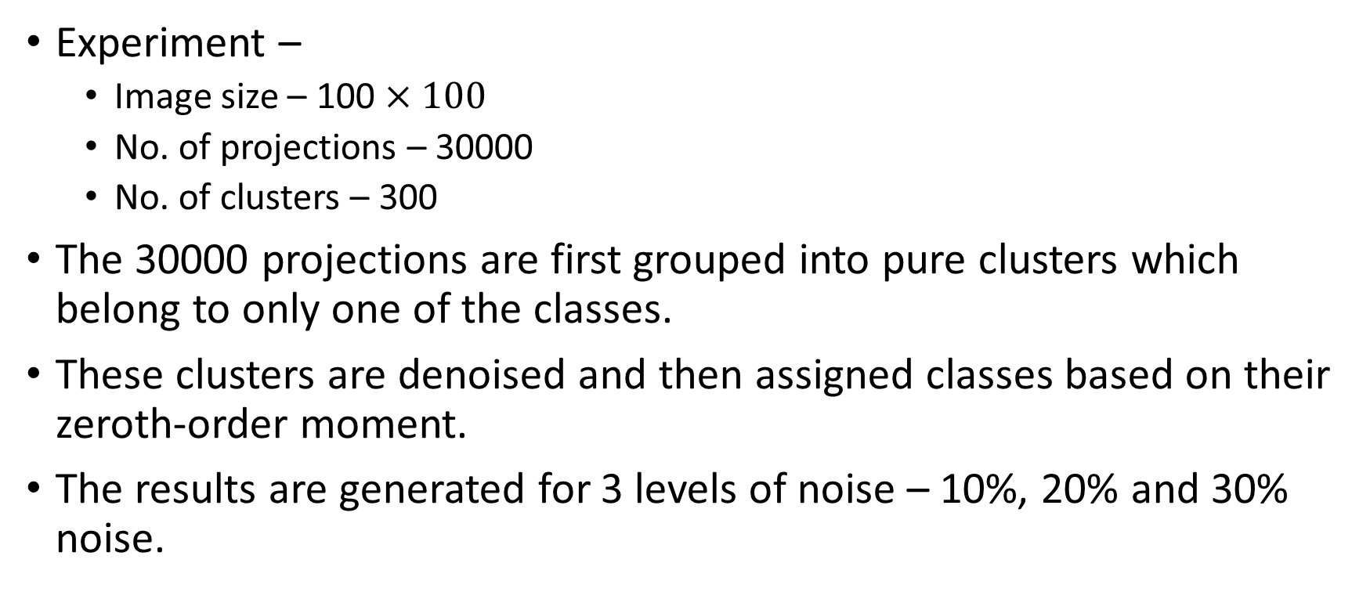
Clustering based on zeroth-moment
Experiment –
Image size – 100 $×100$
No. of projections – 30000
No. of clusters – 300
The 30000 projections are first grouped into pure clusters which belong to only one of the classes.
These clusters are denoised and then assigned classes based on their zeroth-order moment.
The results are generated for 3 levels of noise – 10%, 20% and 30% noise.

Slide 2
Clustering based on zeroth-moment
10% noise
20% noise
Class | Total | Correct | Incorrect | Percentage Correct
1 | 99 | 99 | 0 | 100%
2 | 97 | 97 | 0 | 100%
3 | 104 | 100 | 4 | 96.15%
Class | Total | Correct | Incorrect | Percentage Correct
1 | 87 | 87 | 0 | 100%
2 | 104 | 101 | 3 | 97.12%
3 | 109 | 105 | 12 | 96.33%

Slide 3
Clustering based on zeroth-moment
30% noise
Class | Total | Correct | Incorrect | Percentage Correct
1 | 93 | 93 | 0 | 100%
2 | 100 | 100 | 0 | 100%
3 | 107 | 100 | 7 | 93.46%

Slide 4
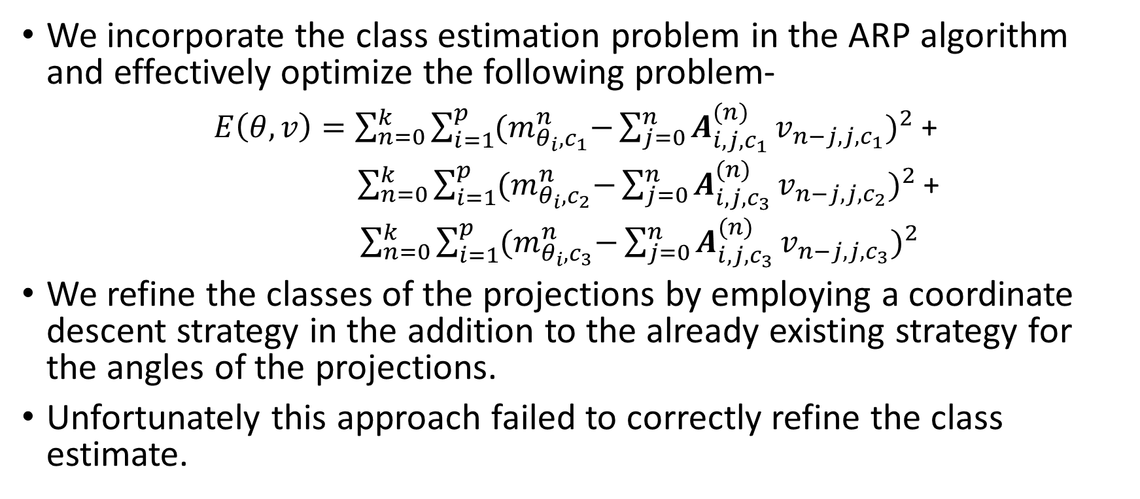
Refinement of Clusters
We incorporate the class estimation problem in the ARP algorithm and effectively optimize the following problem-
$E\left(θ, v\right)=\sum_{n=0}^{k}{\sum_{i=1}^{p}{{(m}_{θ_{i},c_{1}}^{n}−{{\sum_{j=0}^{n}{A_{i,j, c_{1}}^{(n)}}v}_{n−j, j,c_{1}})}^{2}}}$ +
$\sum_{n=0}^{k}{\sum_{i=1}^{p}{{(m}_{θ_{i},c_{2}}^{n}−{{\sum_{j=0}^{n}{A_{i,j,c_{3}}^{(n)}}v}_{n−j, j,c_{2}})}^{2}}}$+
$\sum_{n=0}^{k}{\sum_{i=1}^{p}{{(m}_{θ_{i},c_{3}}^{n}−{{\sum_{j=0}^{n}{A_{i,j,c_{3}}^{(n)}}v}_{n−j, j,c_{3}})}^{2}}}$
We refine the classes of the projections by employing a coordinate descent strategy in the addition to the already existing strategy for the angles of the projections.
Unfortunately this approach failed to correctly refine the class estimate.

Slide 5
Refinement of Clusters-Modified
The moment-based approach is applied separately for each of the classes and the angles are estimated for each of those classes.
After estimating the angles of the clusters, we reconstruct the images for the three classes which serve as our initial estimate for the gradient descent approach.
In the gradient descent based approach, we don’t just assign a class to each cluster. Instead we calculate the probability of a cluster belonging to a certain class based on the current angle estimate and current image estimate.
The probability is estimated by assuming a gaussian-noise model.

Slide 6
Refinement of Clusters-Modified
This probability is incorporated in the reconstruction of the images as well as in the estimation of the angles and shifts.
At the end of the refinement, we assign the class to the cluster which has the most probability.
Unfortunately, even this fails to refine the class estimates and instead gives worst results.
This is because, if the angles estimates are wrong for one iteration, it will most likely give a different class and then the solution converges to a wrong solution.

